Slide 1
Equilibrium

Slide 2
Equilibrium
This occurs when:
The forward reaction rate equals the reverse reaction rate.
The concentration of all substances remains constant – even though each reactant or product may have a different concentration.
The reaction takes place in a closed system
The macroscopic properties such as density and colour remain constant

Slide 3
Reactions and arrows
The reaction of sodium and chlorine is irreversible
Irreversible reactions are represented by a single arrow: →
Irreversible reactions have a low activation energy in one direction, but a high activation energy in the reverse direction
2Na_{(s)} + Cl_{2(g)} → 2NaCl_{(s)}

Slide 4

Reactions and arrows
The reaction of nitrogen and hydrogen to form ammonia is reversible.
Ammonia can also decompose to form nitrogen and hydrogen. Reversible reactions that can reach equilibria are represented by two half arrows: .
N_{2(g)} + 3H_{2(g)} 2NH_{3(g)}

Slide 5
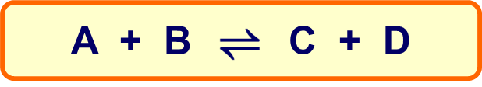
What is equilibrium?
If a reversible reaction is carried out in a closed container so that the reactants and products cannot escape, a state of dynamic equilibrium can be established.
This state is dynamic because both the forward and reverse reactions are ongoing.
It is an equilibrium because:
the rates of the forward and reverse reactions are the same
the net concentrations of the components of the reaction mixture remain constant.

Slide 6
N₂ + 2O₂  2NO₂
Colourless  Brown
Chemical equilibrium systems are dynamic
The two opposing reactions occur simultaneously
There is no loss or gain of energy by the system

Slide 7
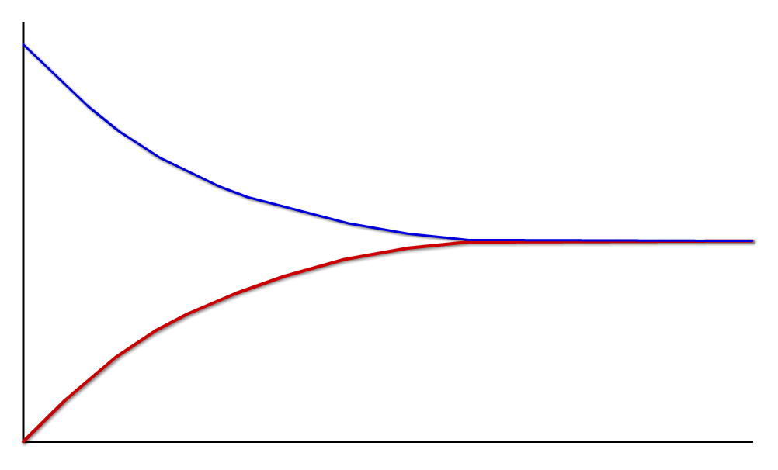
Dynamic equilibrium
This graph illustrates the dynamic nature of equilibrium.
It shows that both the forward and back reactions are taking place: they both have non-zero rate. When their rates are equal, equilibrium is reached.
forward reaction:
2SO_{2(g)} + O_{2(g)} → 2SO_{3(g)}
rates are equal
at equilibrium
reverse reaction:
2SO_{3(g)} → 2SO_{2(g)} + O_{2(g)}
rate
time

Slide 8
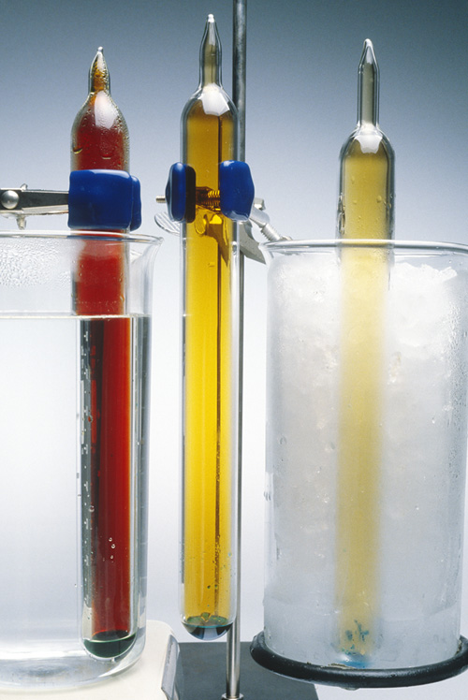
Composition of the reaction mixture
At equilibrium, the proportions of reactants and products present may not be a 50:50 mix.
The proportion of reactants and products depend on the particular reaction, as well as factors such as temperature, concentration and pressure.
However, for a given set of conditions, a particular reaction will always have the same proportions of reactants and products at equilibrium.

Slide 9
Equilibrium Constants
Is represented by an equilibrium expression which
Is a mathematical relationship that relates the concentration of the reactants (those on the left) with that of the products (those on the right of the equation) and at a constant temperature has a constant value, K
K = [products]
[reactants]
eg aA + bB → cC + dD
K = [C]^{c}[D]^{d}
[A]ª[B]^{b}
The powers of the conc of all the species in the expression are the same as their coefficients in the equation

Slide 10
Equilibrium Constants
The higher the value of K the greater the amount of products.
K is dependent on temperature ONLY.
K values are specific for a particular reaction at
a specific temperature
4. Only gases and aqueous solutions are used in the expression.
5. Provides no information on the rate of reaction

Slide 11
Le Chatelier’s Principle
If a chemical system at equilibrium is subjected to a change in the conditions then it will adjust itself topartially counteract the change as equilibrium is re-established
Can be used to predict changes in the relative amount of reactants and products and to predict the shift in equilibrium

Slide 12
Temperature change
Addition of heat to an endothermic reaction will tend to favour the formation of the products. Lowering the temp will favour the reactants
N₂O₄(g) + HEAT  2NO₂
Raising the temperature will shift the equilibrium to …….
the right

Slide 13
Temperature change
Addition of heat to an exothermic reaction will tend to favour the formation of the reactants. Lowering the temp will favour the products
2CO_{(g)} + O_{2(g)}  2CO_{2(g)} + 500kJ
Raising the temperature will shift the equilibrium to …….
The left
LOW temperatures favour exothermic reactions

Slide 14
Temperature change
Increasing the temperature will cause a
Decrease in the equilibrium constant (K) for an exothermic reaction
Increase in the equilibrium constant (K) for an endothermic reaction

Slide 15
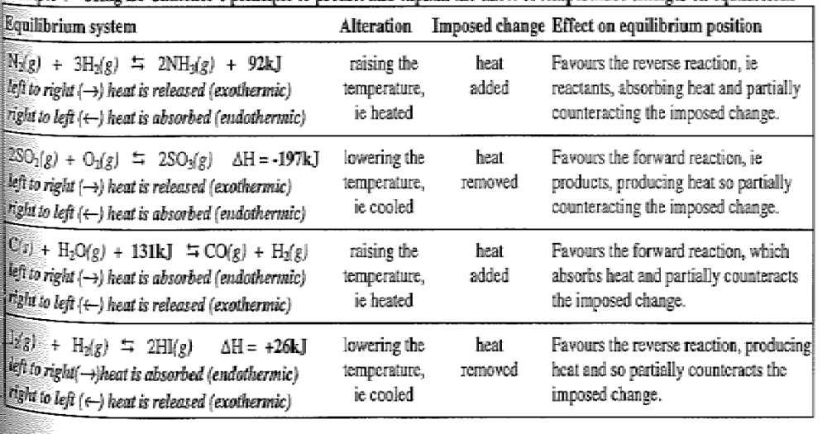
Temperature change

Slide 16
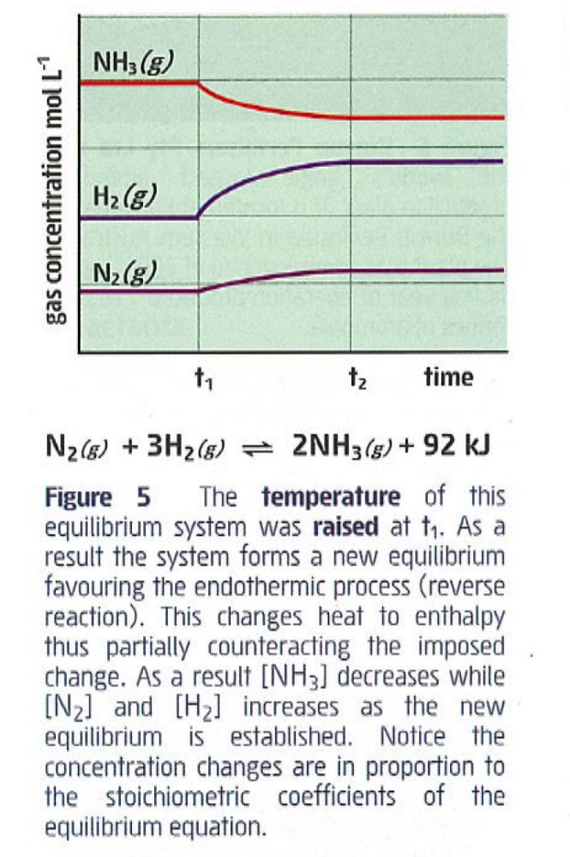

Slide 17
Addition of a catalyst
Increases the rate at which equilibrium is achieved but does not alter the equilibrium position
Provides an alternative pathway of lower activation energy for BOTH forward and reverse reactions but does not alter the concentration of either reactants or products

Slide 18
PRESSURE changes
Only effects GASES
Increasing pressure will tend to decrease the volume
Has similar effect as concentration
Increasing the pressure favours the side of the least gas molecules – less gas = less pressure

Slide 19
PRESSURE changes
H₂ _{(g)} + Cl₂ _{(g)}  2HCl _{(g)}
Changing the pressure on this system has no effect
PCl₃ _{(g)} + Cl₂ _{(g)}  PCl₅ _{(g)}
Increasing the pressure on this system favours the product

Slide 20
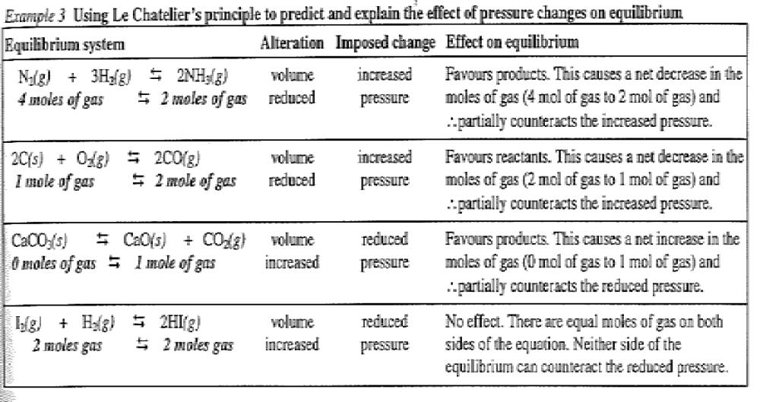
PRESSURE changes

Slide 21
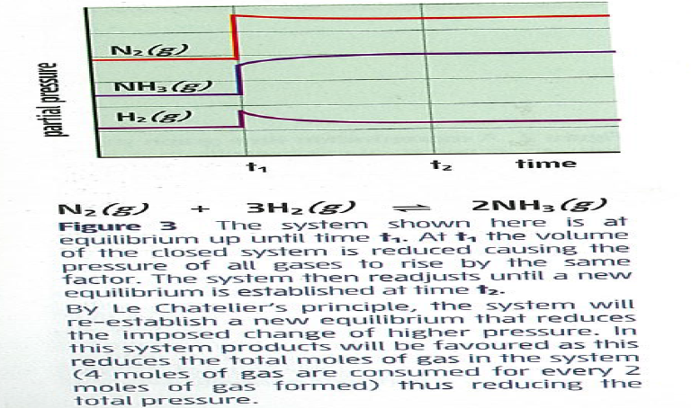
PRESSURE changes

Slide 22
Volume changes
Decreasing the volume of a system will
increase the concentration of all gaseous substances in the system
Favour the side of the least gas molecules

Slide 23
CONCENTRATION changes
Increasing the concentration of a substance will favour the direction which will tend to decrease it.
2SO₂ + O₂  2SO₃ [all gases]
Increasing either reactant will ↑[SO₃]
If ↑[O₂] then [SO₂]↓ and [SO₃]↑
The concentration of solids and liquids are constant – the mass may change but not the [ ]

Slide 24
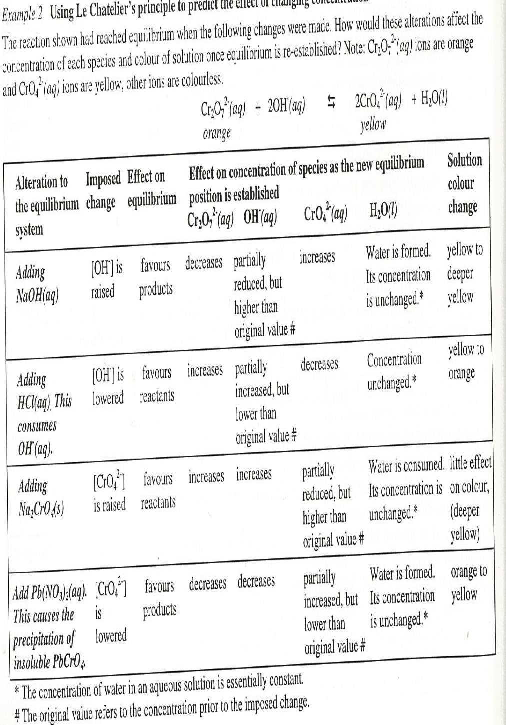
CONCENTRATION changes

Slide 25
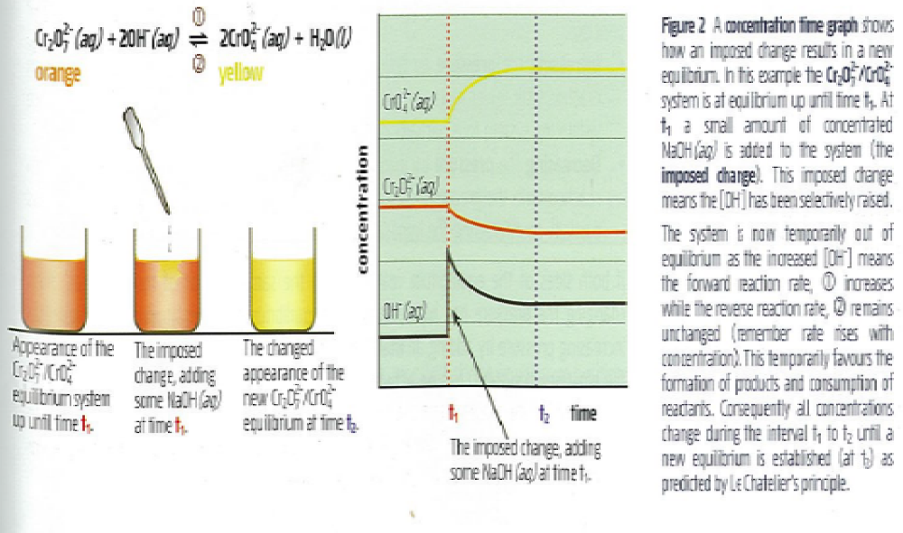
CONCENTRATION changes

Slide 26
Industrial applications
The Haber Process
N₂ + 3H₂  2NH₃ + 92kJ [all gases]
To achieve maximum yield of ammonia
Temp – exo - low temp vs slow RR; compromise 500ºC
Pressure – high = ↑[NH₃] + ↑RR 400atm
Catalyst - ↑RR Fe/Fe₂O₃

Slide 27
Industrial applications
The Contact Process
Used to manufacture sulfuric acid
Series of steps which involve sulfur to sulfur dioxide to sulfur trioxide. Then sulfur trioxide absorbed by water in sulfuric acid.
S_{(s)} + O_{2(g)} → SO_{2(g)} + heat
2SO_{2(g)} + O_{2(g)} → 2SO_{3(g)} + heat
SO_{3(g)} + H₂O(H₂SO₄)_{(l)} → H₂SO_{4(l)} + heat

Slide 28
The Contact Process
To achieve maximum yield of SO₃
Temp – exo - low temp vs slow RR; compromise 500ºC
Pressure – high = ↑[SO₃] + ↑RR 2 atm
Catalyst - ↑RR V₂O₅ vanadium pentoxide

